Slide 1


LAMBDA FUNCTIONS AND DYNAMIC ARRAYS

Slide 2
Agenda
The Why
Business Use Cases
Cell Reference Hell
Lambda Libraries
GitHub
ChatGPT
The How
Functional Fundamentals
Comparing Dependency Patterns
List and Tuples are missing

Slide 3
The Why

Slide 4




Uses of Excel
Data Processes
Results Illustration
Explaining Code

Slide 5
Business Use Cases
Product Illustration
Speeds up passing and understanding of logic by third parties
Non-Guaranteed Elements
Allows to logic to centralized in a single location thereby promoting calculation consistency across multiple cohorts
Model Validation
Can have a library of tested and approved calculations to validate models
Reduce Redundant Business Logic
A single library of calculations that dropped into a spreadsheet to reduce project timelines.

Slide 6
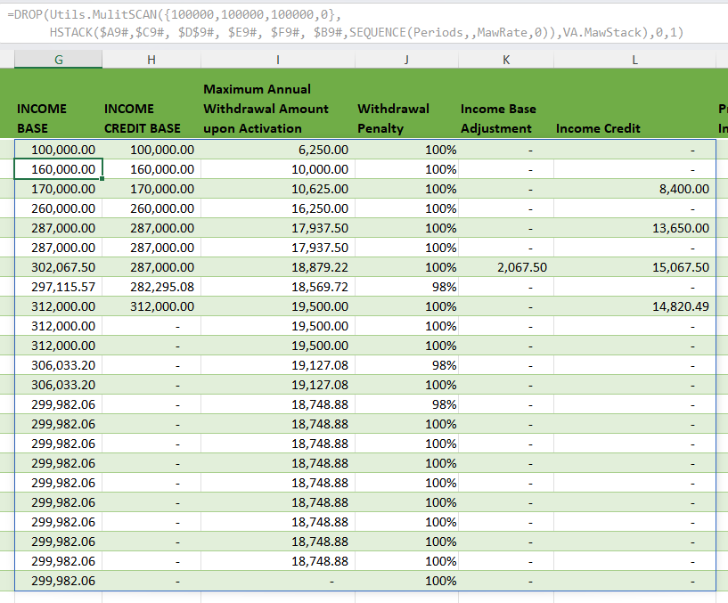

Dynamic Arrays
Dynamic Arrays in Excel 365 let you work with a range of values in a single cell.
Instead of entering a formula that outputs to a single cell, you can use a formula that "spills" results into neighboring cells automatically.
There are significant concepts to consider:
Spilling: The formula automatically fills cells with multiple values.
Dynamic: The output adjusts if the source data or formula changes.
Functions: Lambda functions can be applied consistently over the entire array.
Dynamic Arrays can be seen as super cells.
Dynamic Array Function Documentation: https://www.thespreadsheetguru.com/dynamic-array-function-list/

Slide 7
The Problem Statement
Withdrawal Penalty - Classic
=IF($C9 <> 0,IF($F9, 1 - MAX(0, $C9 - $P8) / ($D8 - $P8), 1 - $C9 / $D9), 1)
Cell References scattered through logic, which is source of the problem and the root of cell reference hell.
Avoid dual concerns!
Withdrawal Penalty - Map
=MAP( $D8 , $P8 , $C9 ,$D9, $F9 , $P9,
LAMBDA(prevCV, prevMAWA, WdTaken, Cv, isActivated, mawa,
LET(noWd, 1,
IF(WdTaken <> 0,
IF(isActivated,
1 - MAX(0, WdTaken - prevMAWA) / (prevCV - prevMAWA),
1 - WdTaken / Cv),
noWd))
)
)
Mapping a cell references to Lambda parameters.
All logic is separated from cell references, so moving the right direction.
Better, but still has problem of not understanding the logic between columns.

Slide 8

Wringing Out Logic into Lambda Libraries

Slide 9
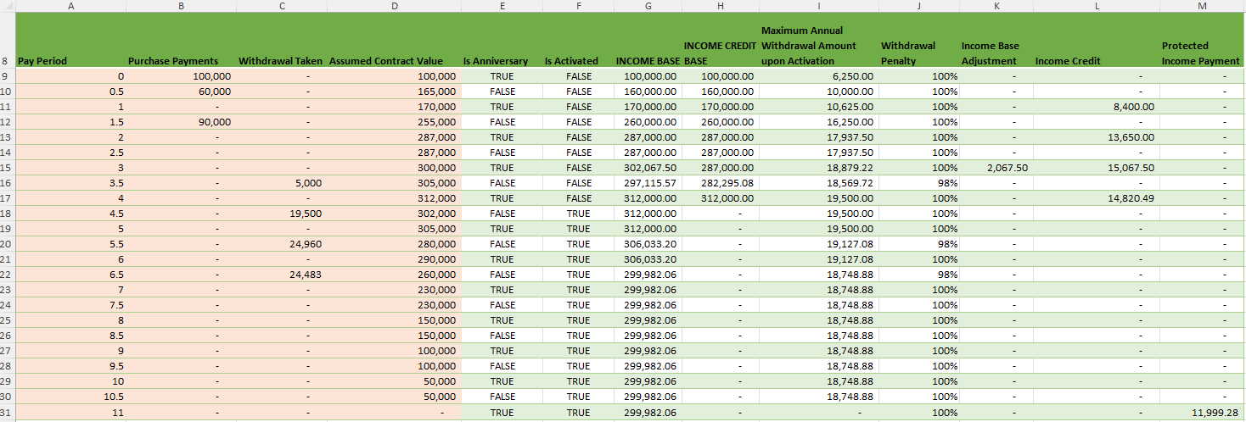
Smart Lambda Libraries Make Dumb Spreadsheets!
Pay Period =SEQUENCE(Periods,,0,1/2)
Purchase Payments = 100000
Withdrawal Taken = 0
Assumed Contract Value = 100000
Is Anniversary =VA.IsAnniversary(A9#)
Is Activated =VA.IsActivated(A9#,ActivationPeriod)
INCOME BASE =DROP(
Utils.MulitSCAN({$C$9, $C$9, $C$9,0},
HSTACK($A9#,$C9#, $D$9#, $E9#, $F9#, $B9#,SEQUENCE(Periods,,MawRate,0)),
VA.MawStack)
,0,1)
Protected Income Payment =MAP($D$9#,CHOOSECOLS($G$9#,1),SEQUENCE(Periods,,pipRate,0),VA.ProtectedIncomePayment)
Being dumb is great!
No business logic in cells
Only location references to inputs

Slide 10
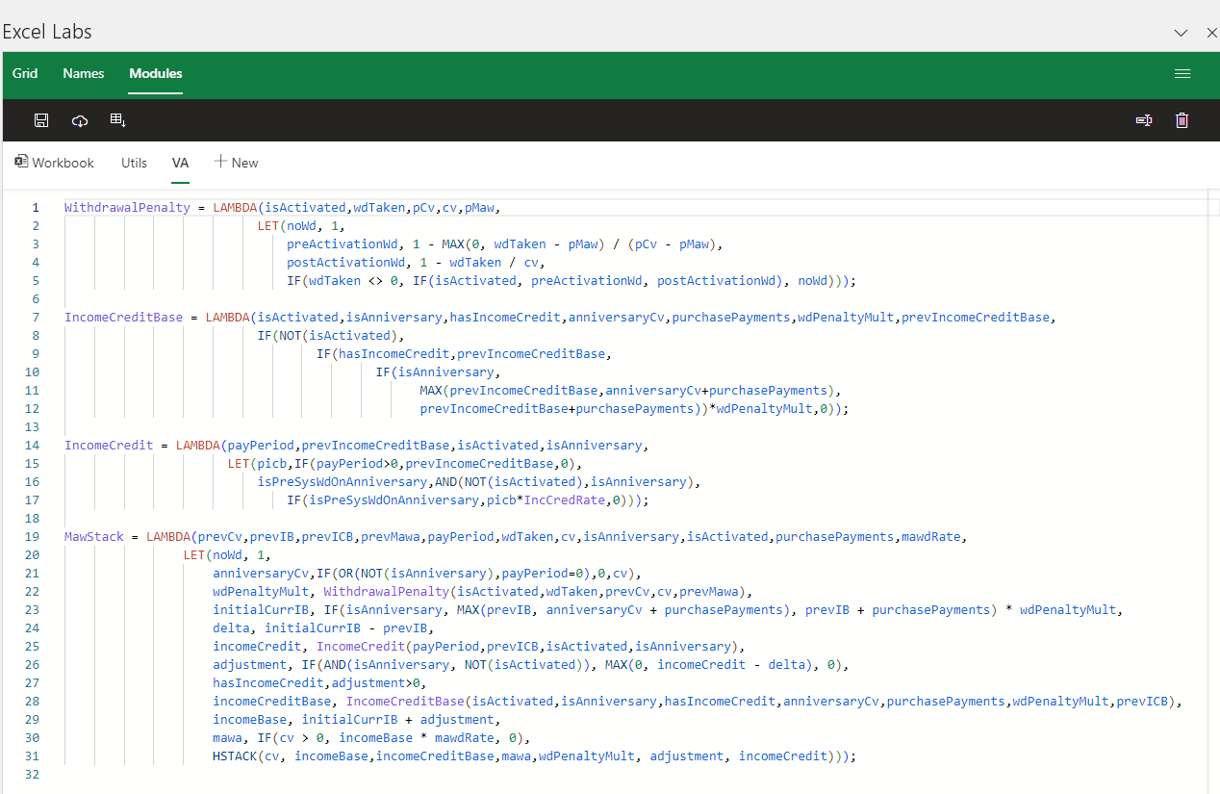
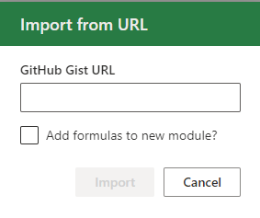
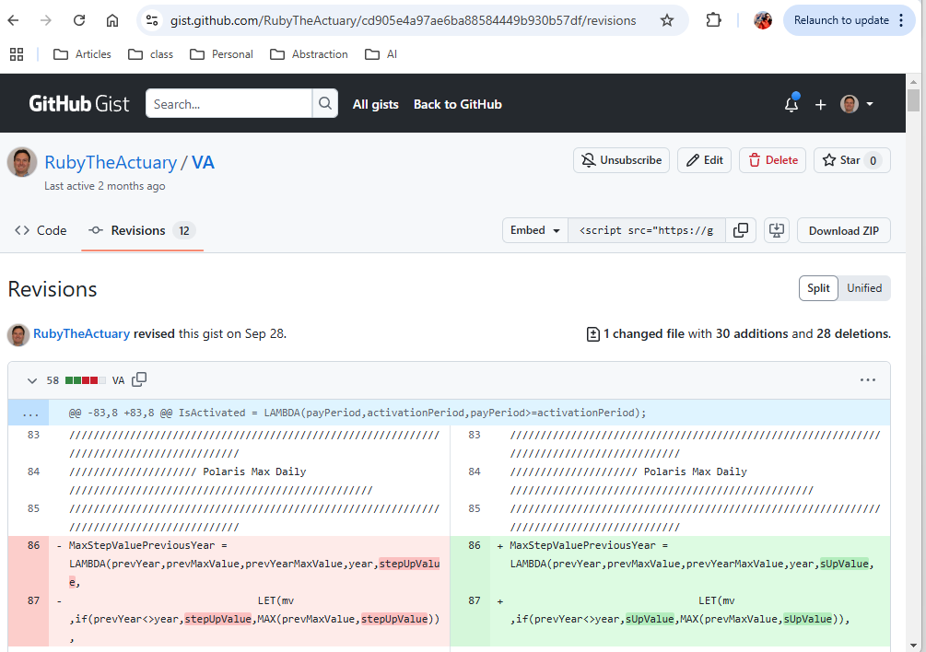
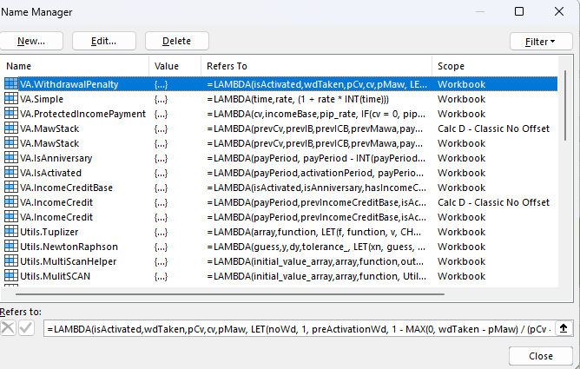
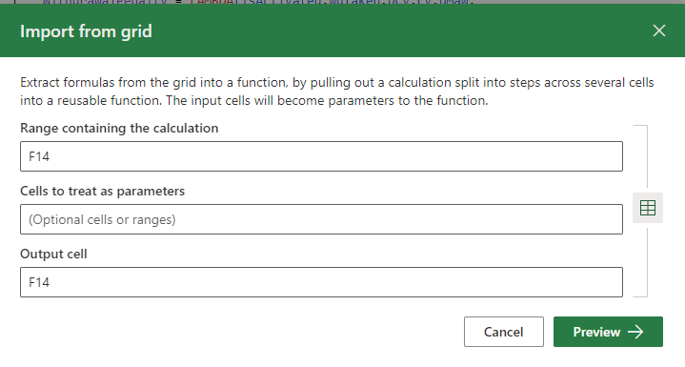
Advance Formula Environment (AFE)
Used for managing reusable libraries
Libraries can be saved into different modules
Updates can be easily saved
New formulas imported from spreadsheet into the library
New versions can be downloaded from GitHub.
https://gist.github.com/RubyTheActuary/cd905e4a97ae6ba88584449b930b57df
https://www.microsoft.com/en-us/garage/profiles/excel-labs/

Slide 11
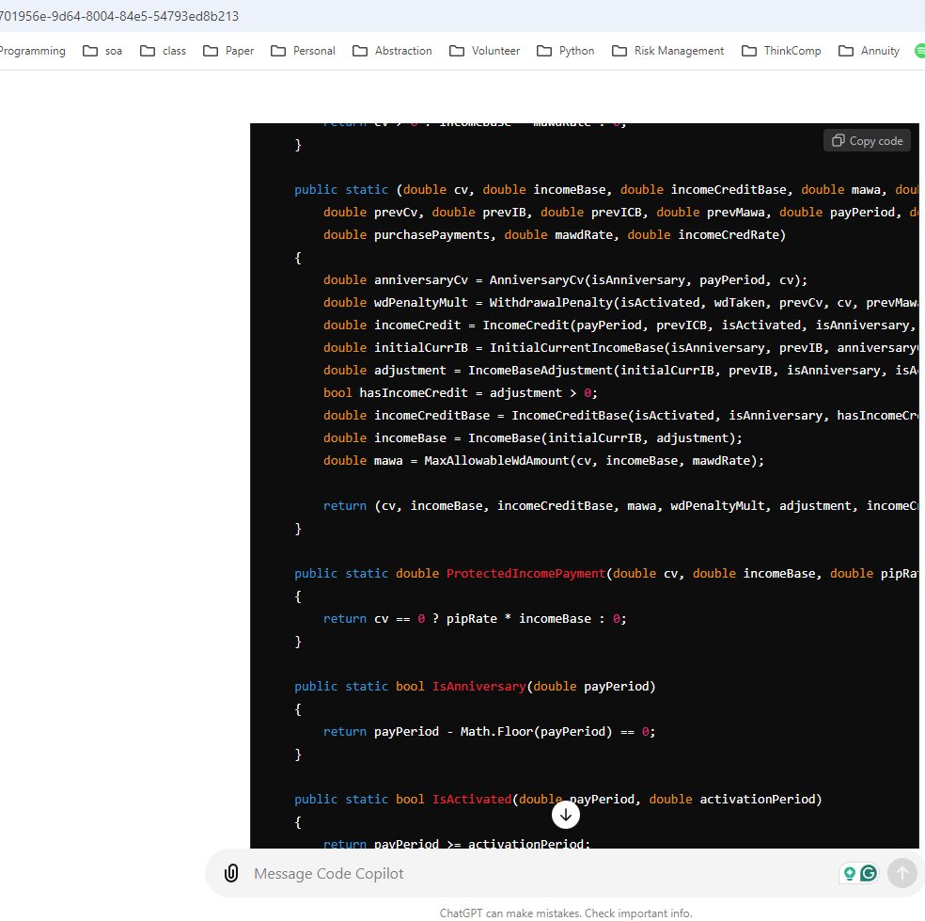
Converting Libraries for other Systems
Typed in to ChatGPT 4.0: Convert Excel Lambdas to C# Followed by Lambda Library Code.
https://chatgpt.com/

Slide 12
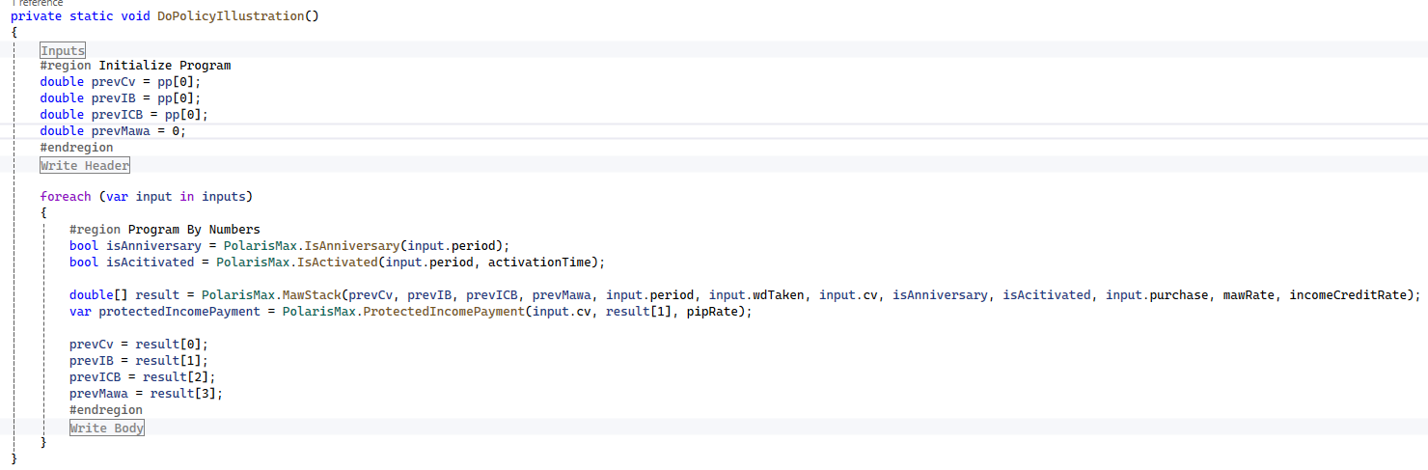
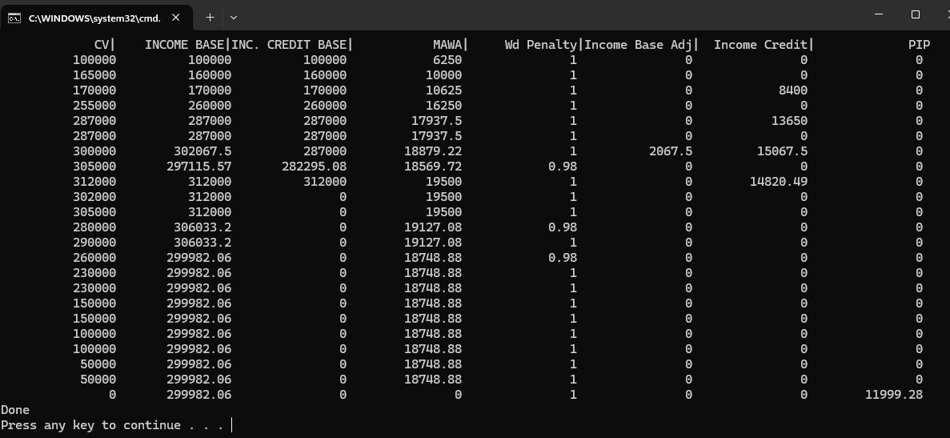
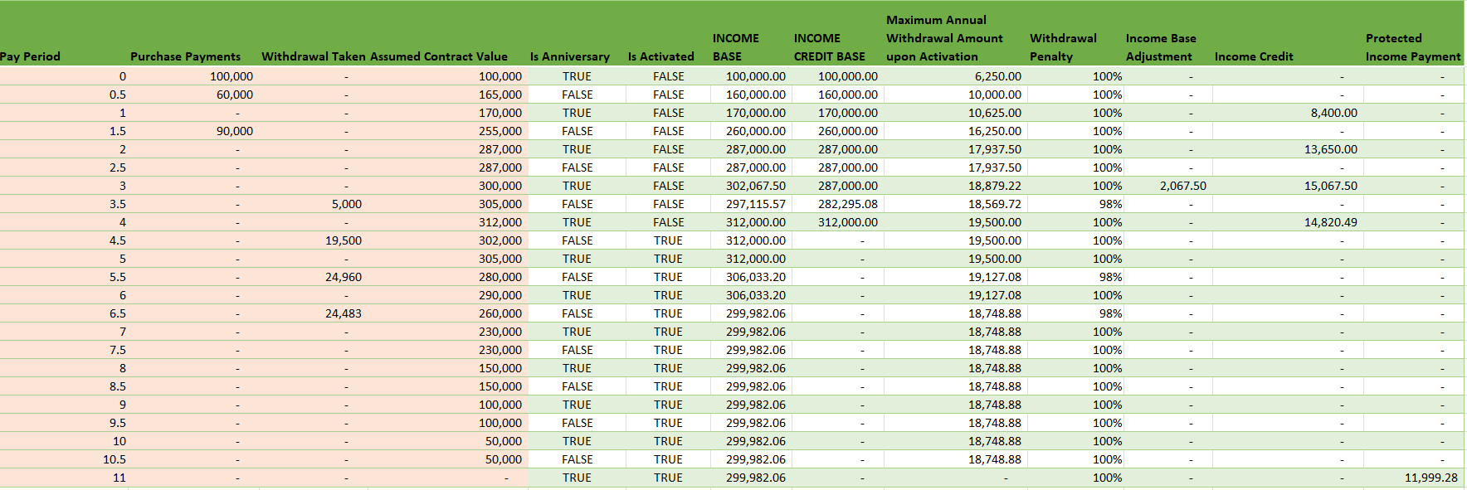
Bang Out Prototype to Match Excel
Pay Period =SEQUENCE(Periods,,0,1/2)
Purchase Payments = 100000
Withdrawal Taken = 0
Assumed Contract Value = 100000
Is Anniversary =VA.IsAnniversary(A9#)
Is Activated =VA.IsActivated(A9#,ActivationPeriod)
INCOME BASE =DROP(
Utils.MulitSCAN({$C$9, $C$9, $C$9,0},
HSTACK($A9#,$C9#, $D$9#, $E9#, $F9#, $B9#,SEQUENCE(Periods,,MawRate,0)),
VA.MawStack)
,0,1)
Protected Income Payment =MAP($D$9#,CHOOSECOLS($G$9#,1),SEQUENCE(Periods,,pipRate,0),VA.ProtectedIncomePayment)

Slide 13
Why Dynamic Arrays and Lambda Functions?
We separate logic from cell references, which makes logic easier to understand and shareable
We can create a reusable library of components
User-friendly and free version control of changes
Libraries can be easily converted to other languages
Functions can be tested independent and debugged independent of the actual calculation.

Slide 14
The How

Slide 15
Actuarial calculations will likely cause circular references with dynamic arrays and lambda functions.
Warning!
An intentional design and not a bug.
From here on out, I will show how to deal with this.

Slide 16
Executive Summary
Lambda Functions and Dynamic Arrays were inspired by a specific software engineering paradigm.
To understand the behavior of these new features, you need to understand the paradigm.
Philosophy
Properties
Features
Working with formula auditing and understanding the dependency patterns of your formulas is mission critical

Slide 17
Programming Paradigms
Structured Paradigm
Example Languages: VBA, C, Pascal, Fortran, COBOL, Classic Excel
Programming Philosophy: By order of operation much like a task list
Object Oriented Paradigm
Example Languages: C++, C#, VB.NET, Java, SmallTalk
Programming Philosophy: By assigning responsibilities to class, much like a manager delegating to teammates
Functional Paradigm
Example Languages: Haskell, F#, Scala
Programming Philosophy: objects can be thought of as data types, and morphisms (arrows) as functions that transform one type of data into another.

Slide 18

Functional Programming Fundamentals

Slide 19
Functional Programming Concepts
First Class Citizen:
Let(a,2,
f, Lambda(x,x^2), // First class citizen
f(a) ) //result=4
Mutable:
=Let(a,1,
a,2,//Not Allowed
a) //return a
Pure Function:
Lambda(x, y, x+y)
Impure Function:
Lambda(x, y, x+ y + global_variable)
The central concepts are:
Pure functions: Functions that return the same output for the same input and have no side effects.
Immutability: Corresponds to unchangeable data structures after their creation.
Functions as first-class citizens: Functions can be variables just like int and string.
Higher-order functions: Functions that take other functions as arguments or return functions.
Function composition: Combining functions to create more complex functions.
Recursion: Due to immutability, there is no concept of a for or while loop like in procedural languages. To iterate over a structure requires recursion, which is a function that calls itself.

Slide 20
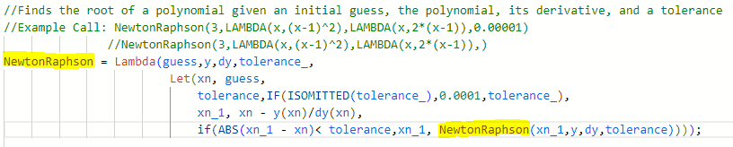
Lambdas and Recursion – Simple Example
Demonstrates:
Recursion
Higher-order functions
Functions as first-class citizens
Function composition

Slide 21
Important Lambda/Functional Helper Functions
MAP : Uses 1 to many arrays to transform to a single result
REDUCE: Compresses an array to a single value. Classic Example: SUM or PRODUCT
SCAN: Is a running total. Can be used to validate a REDUCE function.
HSTACK : Stacks column ranges
VSTACK : Stacks row ranges
DROP : Drops the first item from a range
TAKE: Takes the first item from a range
ISOMITTED: True if parameter omitted from lambda function.
https://www.thespreadsheetguru.com/dynamic-array-function-list/

Slide 22

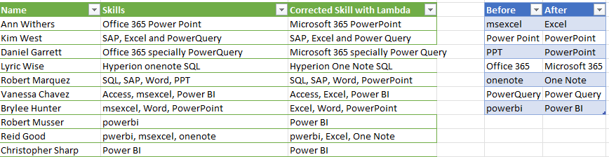
Mega Replace Recursion
Popular personality on building Excel functionality.
She built a recursive equation to fix text strings.
Her explanation is great, but it can be improved.
Mega Replace - https://www.youtube.com/watch?v=L7s6Dni1dG8

Slide 23
Recursion and Purity
Correcting Video’s Formula
MegaReplaceFix =
LAMBDA(text,beforeArray,afterArray,
LET(bef,TAKE(beforeArray,1),aft,TAKE(afterArray,1),v,SUBSTITUTE(text,bef,aft),
IF(COUNTA(beforeArray)-1=0,
v,
MegaReplaceFix(v,DROP(beforeArray,1),DROP(afterArray,1)))
)
5
2
3
6
7
4
1
TEXT / INPUT | Before Array | After Array | ANSWER
Office 365 Power Point | msexcel | Excel | Office 365 Power Point
Office 365 Power Point | Power Point | PowerPoint | Office 365 PowerPoint
Office 365 PowerPoint | PPT | PowerPoint | Office 365 PowerPoint
Office 365 PowerPoint | Office 365 | Microsoft 365 | Microsoft 365 PowerPoint
Microsoft 365 PowerPoint | onenote | One Note | Microsoft 365 PowerPoint
Microsoft 365 PowerPoint | PowerQuery | Power Query | Microsoft 365 PowerPoint
Microsoft 365 PowerPoint | powerbi | Power BI | Microsoft 365 PowerPoint

Slide 24
Recursion and Impurity
The Video’s Formula
MegaReplace =
LAMBDA(text,beforeText,afterText,
LET(result,SUBSTITUTE(text,beforeText,afterText),
IF(beforeText="",text,MegaReplace(result,
OFFSET(beforeText,1,0),
OFFSET(afterText,1,0)))));
TEXT / INPUT | Before Text | After Text | ANSWER
Office 365 Power Point | msexcel | Excel | Office 365 Power Point
Office 365 Power Point | Power Point | PowerPoint | Office 365 PowerPoint
Office 365 PowerPoint | PPT | PowerPoint | Office 365 PowerPoint
Office 365 PowerPoint | Office 365 | Microsoft 365 | Microsoft 365 PowerPoint
Microsoft 365 PowerPoint | onenote | One Note | Microsoft 365 PowerPoint
Microsoft 365 PowerPoint | PowerQuery | Power Query | Microsoft 365 PowerPoint
Microsoft 365 PowerPoint | powerbi | Power BI | Microsoft 365 PowerPoint
 |  |  | Microsoft 365 PowerPoint

Slide 25
Reduction and Higher-Order Functions
Best Correction for Video Formula
SCAN
MegaReplace2 = REDUCE(startingTextValue,
MAP(beforeArray,afterArray,
LAMBDA(beforeRow,afterRow,
LAMBDA(t,SUBSTITUTE(t,beforeRow,afterRow))))
,LAMBDA(text1,func,func(text1)));
INPUT | REDUCE Explanation | ANSWER
Office 365 Power Point | LAMBDA(Office 365 Power Point,SUBSTITUTE(Office 365 Power Point,msexcel,Excel)) | Office 365 Power Point
Office 365 Power Point | LAMBDA(Office 365 Power Point,SUBSTITUTE(Office 365 Power Point,Power Point,PowerPoint) | Office 365 PowerPoint
Office 365 PowerPoint | LAMBDA(Office 365 PowerPoint,SUBSTITUTE(Office 365 PowerPoint,PPT,PowerPoint) | Office 365 PowerPoint
Office 365 PowerPoint | LAMBDA(Office 365 PowerPoint,SUBSTITUTE(Office 365 PowerPoint,Office 365,Microsoft 365) | Microsoft 365 PowerPoint
Microsoft 365 PowerPoint | LAMBDA(Microsoft 365 PowerPoint,SUBSTITUTE(Microsoft 365 PowerPoint,onenote,One Note) | Microsoft 365 PowerPoint
Microsoft 365 PowerPoint | LAMBDA(Microsoft 365 PowerPoint,SUBSTITUTE(Microsoft 365 PowerPoint,PowerQuery,Power Query) | Microsoft 365 PowerPoint
Microsoft 365 PowerPoint | LAMBDA(Microsoft 365 PowerPoint,SUBSTITUTE(Microsoft 365 PowerPoint,powerbi,Power BI) | Microsoft 365 PowerPoint
BeforeArray | AfterArray | Result of Map which transformed two strings -> function
msexcel | Excel | LAMBDA(t,SUBSTITUTE(t,msexcel,Excel)))
Power Point | PowerPoint | LAMBDA(t,SUBSTITUTE(t,Power Point,PowerPoint)))
PPT | PowerPoint | LAMBDA(t,SUBSTITUTE(t,PPT,PowerPoint)))
Office 365 | Microsoft 365 | LAMBDA(t,SUBSTITUTE(t,Office 365,Microsoft 365)))
onenote | One Note | LAMBDA(t,SUBSTITUTE(t,onenote,One Note)))
PowerQuery | Power Query | LAMBDA(t,SUBSTITUTE(t,PowerQuery,Power Query)))
powerbi | Power BI | LAMBDA(t,SUBSTITUTE(t,powerbi,Power BI)))
https://support.microsoft.com/en-us/office/scan-function-d58dfd11-9969-4439-b2dc-e7062724de29

Slide 26
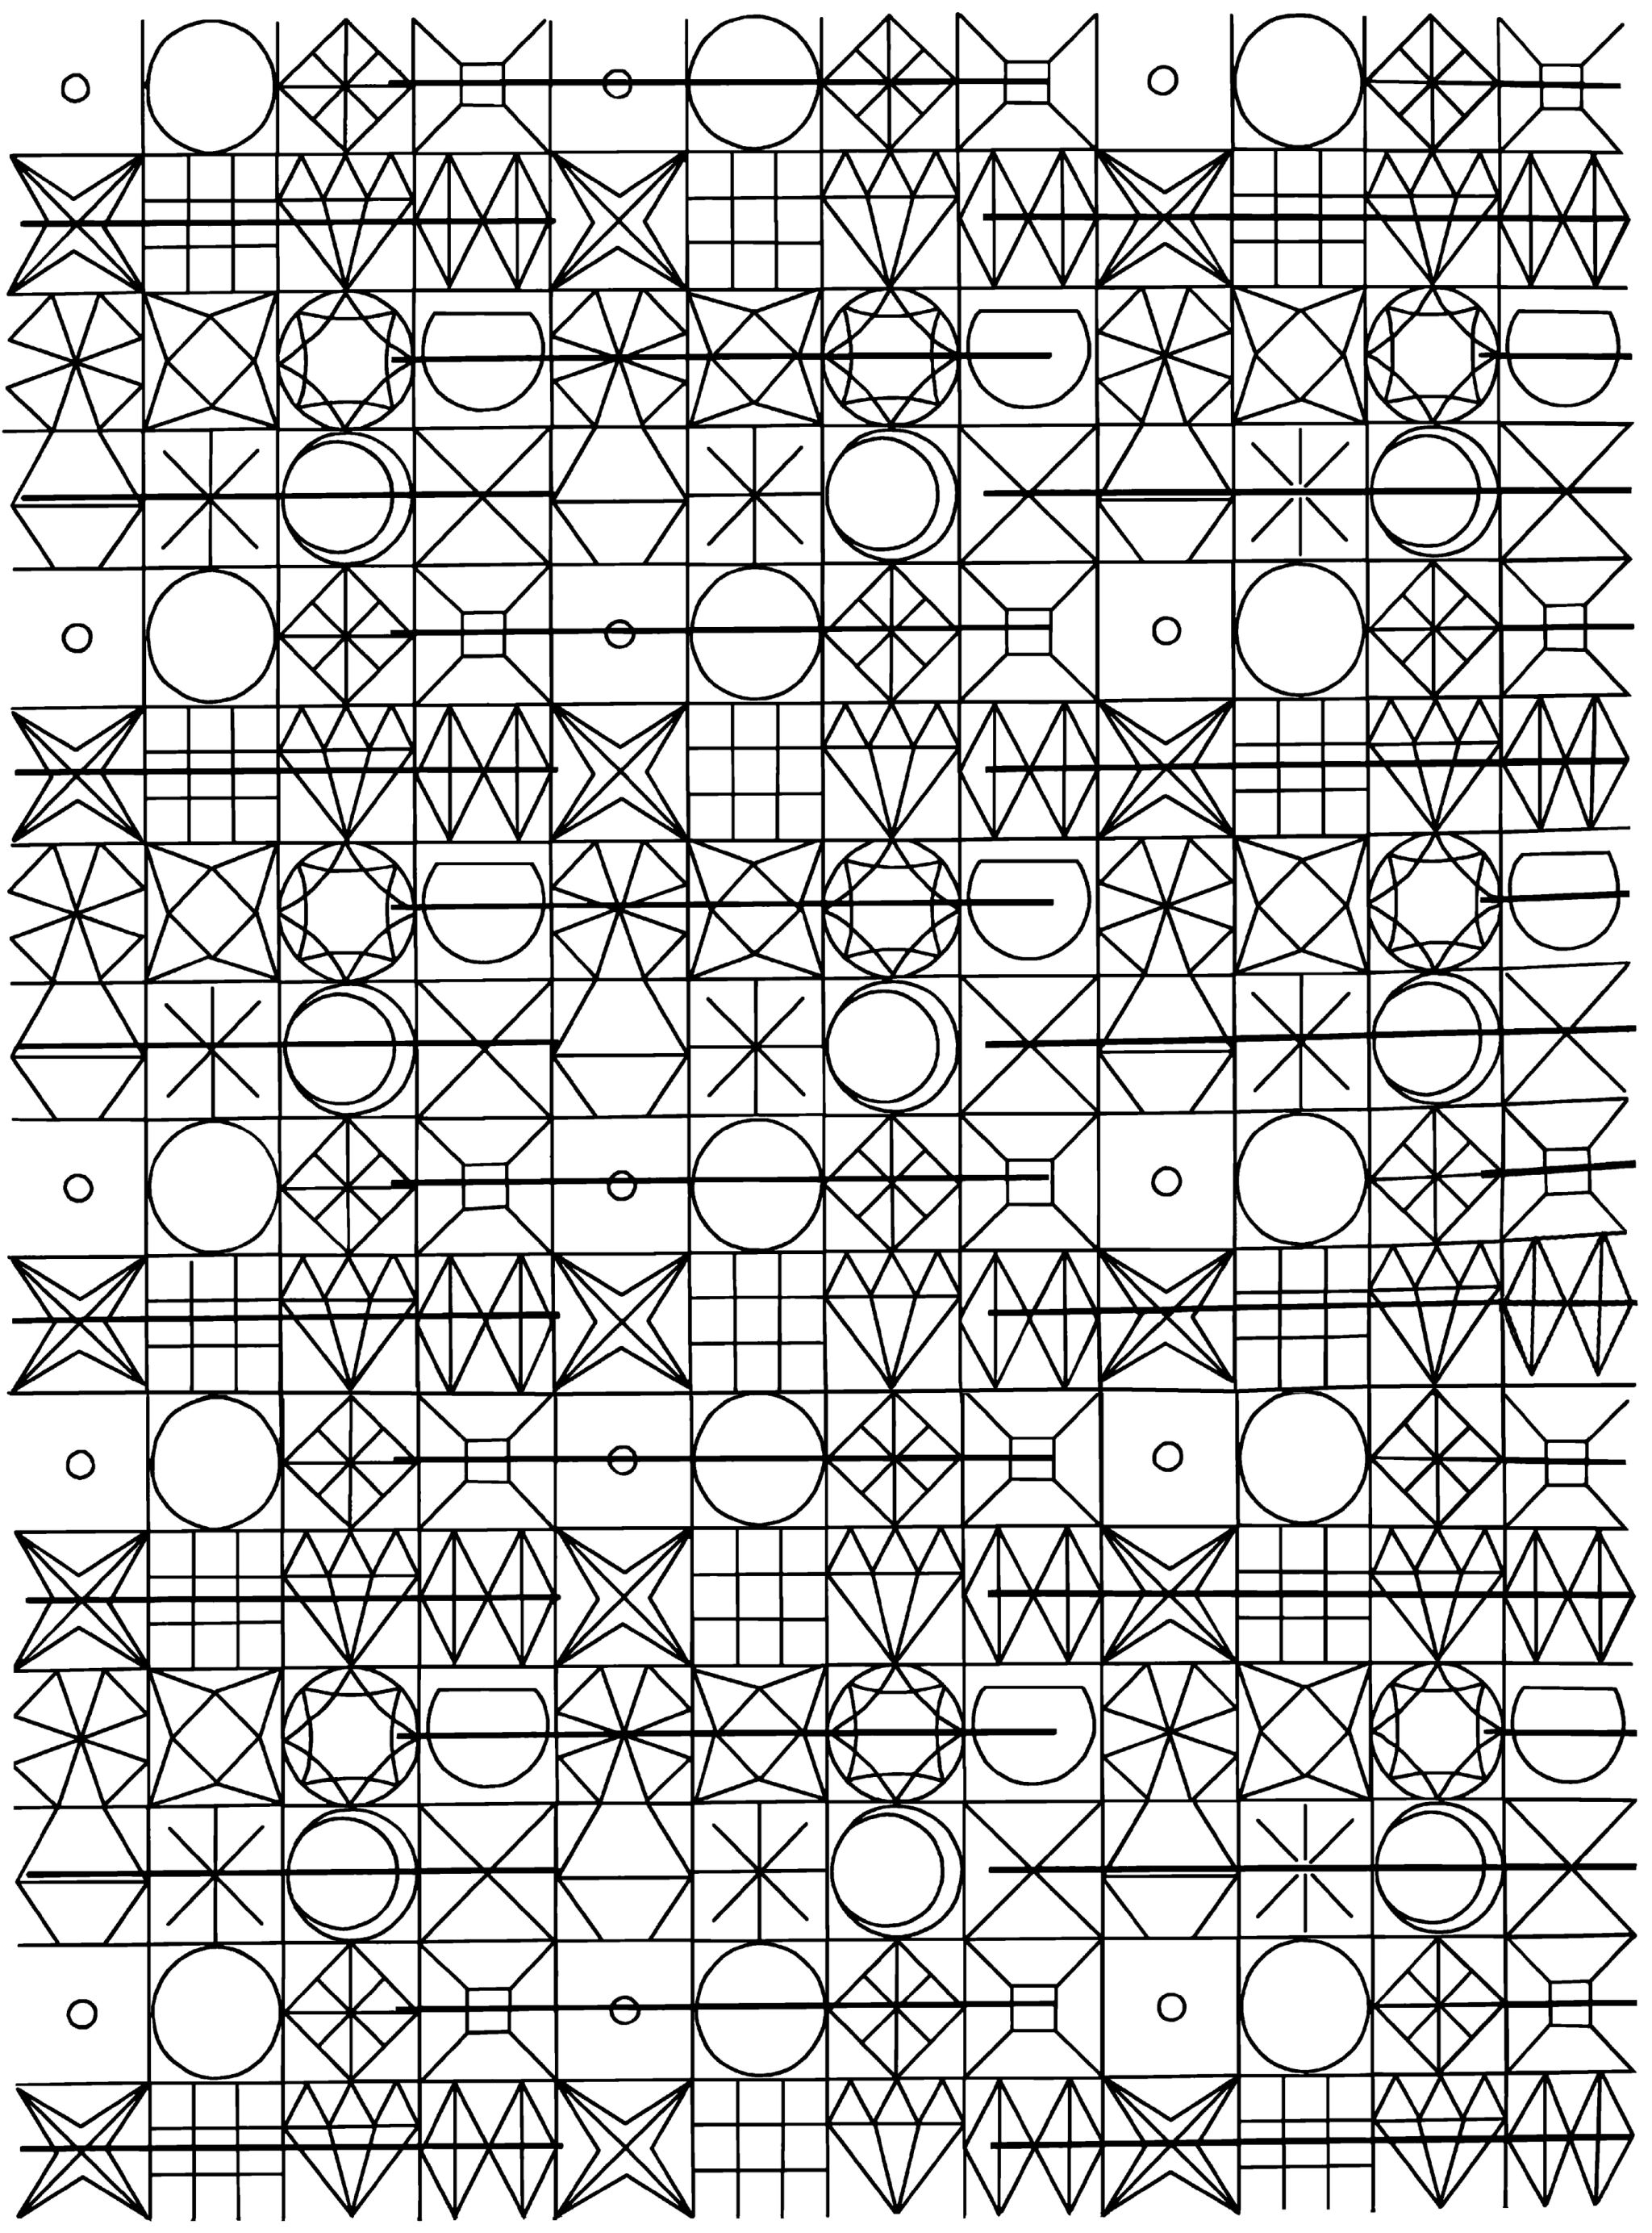
Comparing Dependency Patterns

Slide 27
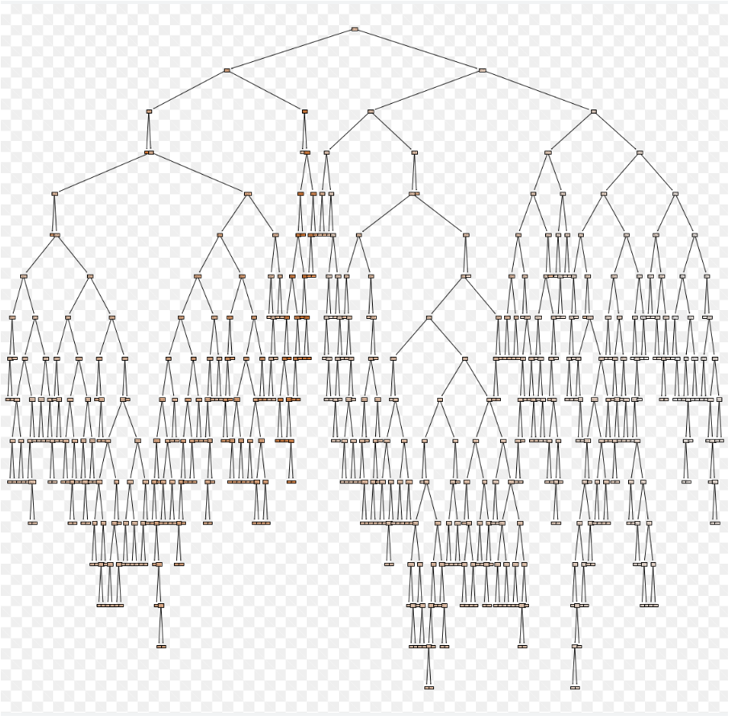
Classic Excel – Calculation Tree
When formulas are made Excel will determine the order of operation.
If the tree has any leaf that points to itself, then a circular reference occurs.
Lastly roll all results to the root node.
Ohio National Life Assurance Corporation
A member of the Constellation Insurance Inc. family of companies

Slide 28
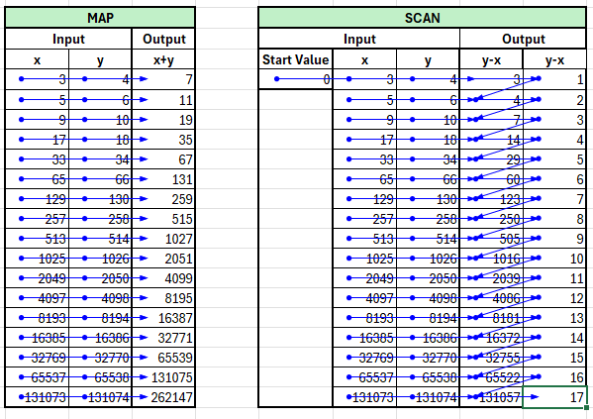
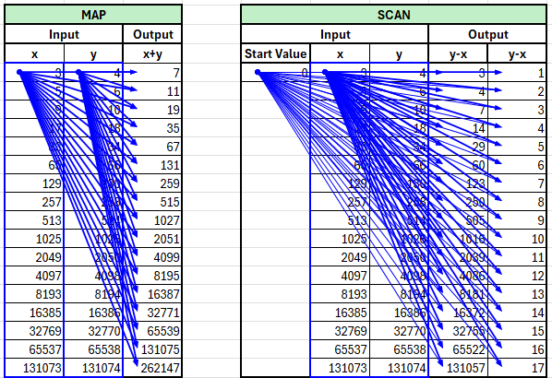
Compare Dependency Patterns
Classic Excel
Notice how the dependency refers to individual cells as you move down the column.
Calculations are garbage.
The same but different approaches.
They are not important.
Pay attention to the dependency pattern differences in blue only.
Excel 365
Notice how the dependency always refers to the starting cells of the input and spills into the output dynamic array.
MAP =B5+C5
SCAN =G5-F5; =H5-G5; =G6-J5; =H6-I6
=MAP($C$5:$C$21,D5:D21,LAMBDA(x,y,x+y))
=SCAN($G$5,$H$5#,LAMBDA(acc,curr,curr-acc))

Slide 29
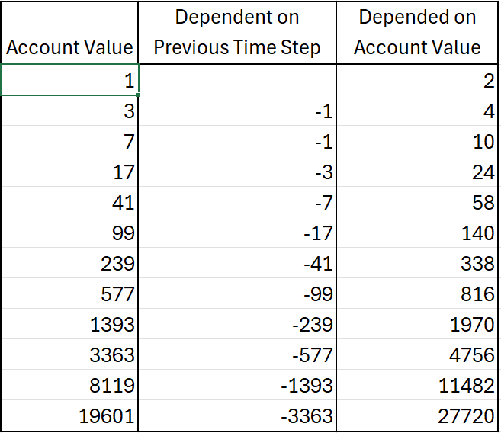
Understanding Complicated Dependencies in Classic Excel Illustrations
Notice the Functional Triangle that causes the circular reference when only using dynamic arrays and lambda helper functions.
This is a very common pattern with annuities due to the interaction between benefit bases and account values.
This pattern will force you to create a lambda library by consolidating logic between columns.

Slide 30
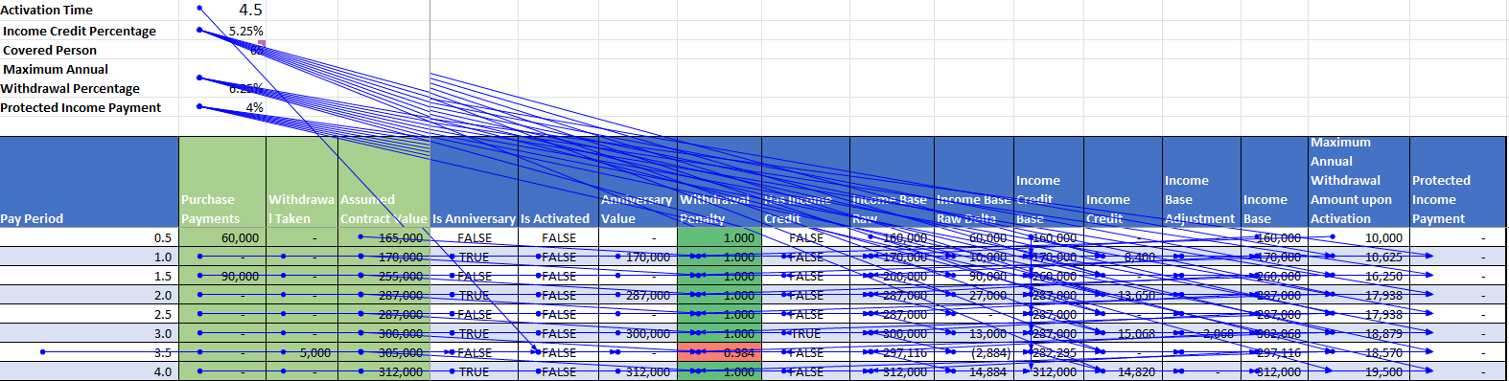
A Complicated VA Prospectus Classical Dependencies
Very complicated inner relationship among the dependencies even in this simplified example.
Even though complicated, there are no circular references in this classic Excel implementation.
Follows the SCAN and Death V dependency patterns.

Slide 31
Programming By Numbers

Slide 32
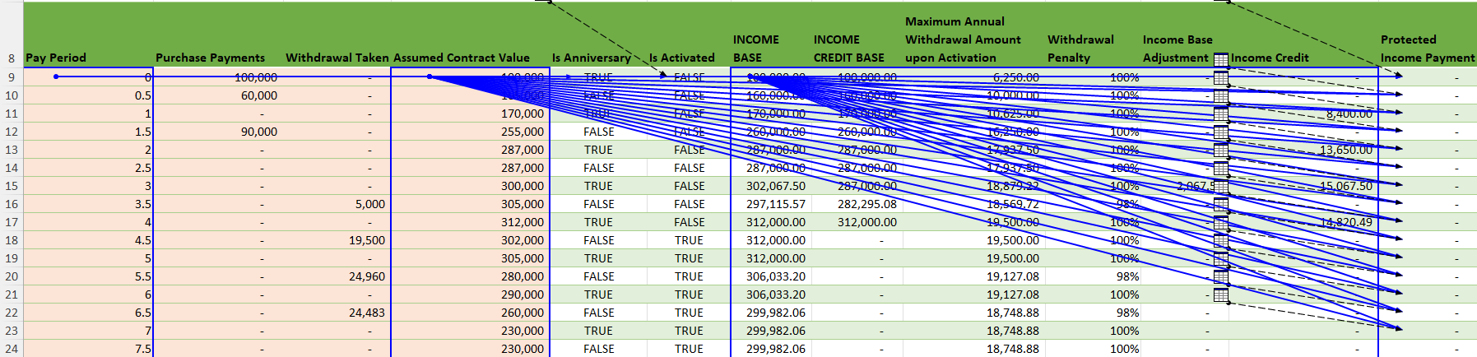
A Complicated VA Prospectus Dynamic Arrays Dependencies
See how the Illustration with dynamic arrays follow the pattern after logic has been extracted into the library.
Bad News: Requires a little more programming chops.

Slide 33

Issue with Divergence from Functional Programming.

Slide 34
More Functional Fun
List
Collection of items of the same type
Tuple
Collection of items of different types, which is a new type.
Used to create an object with different properties.
For example: Policyholder properties are issue age, gender, premium amount.
The tuple named policyholder would contain and integer, string, double.
The policyholder extract would be a list of policyholder tuples.
Problem: Excel combines these concepts.
It may sound a good simplification, but it complicates greatly!

Slide 35
Lambda Helper Limitation / No Tuples
MegaReplace2 = REDUCE(startingTextValue,
A2:B8
,LAMBDA(before,after,text1, SUBSTITUTE(text1,before,after)));
MegaReplace2 = REDUCE(startingTextValue,
MAP(beforeArray,afterArray,
LAMBDA(before,after,
LAMBDA(t,SUBSTITUTE(t,before,after))))
,LAMBDA(text1,func,func(text1)));
SCAN / REDUCE functions
Scans an array by applying a LAMBDA to each value and returns an array that has each intermediate value.
Reduce returns the last value of the Scan.
Syntax
=SCAN ([initial_value], array, lambda(accumulator, value, body))
Example= SCAN(1, A1:C2, LAMBDA(a,b,a*b))
Example=REDUCE(1, A1:C2, LAMBDA(a,b,a*b))
The SCAN or Reduce function syntax has the following arguments and parameters:
[initial_value] Sets the starting value for the accumulator.
array An array to be scanned.
lambda A LAMBDA that is called to reduce the array. The LAMBDA takes three parameters:
accumulator The value totaled up and returned as the final result.
value The current value from the array.
body The calculation applied to each element in the array.
Problems with Scan, Reduce, Map:
Excel treats each cell independently.
The initial_value expects an individual value instead of a list of values.
Problem this forces me to roll my own, which increase the need for programming chops.

Slide 36
Conclusion
The bad
It will require actuaries to increase their programming chops.
Purely functional programming is a very different mindset than the imperative mindset of VBA.
The good
By relying only on lambda functions and dynamic arrays, we can greatly speed up the ability to communicate complicated logic to other interested parties.
We can easily read, translate, and version control business logic of the Excel code.
Reads far more mathematical and easier to relate to actuarial textbooks.
Given we are more accustomed to functional programming, I think it will give us 10X speed up for creating illustrations due to reusability of lambda libraries.
The tradeoff is worth it because it will increase the problem-solving capabilities of everyone involved.
Learning different programming paradigms is always worth the effort.
The new paradigm forces you into better programming habits
https://github.com/RubyTheActuary/Excel-Lambda-Examples

